Slide 1
The Role of a Predecessor Rainfall Event (PRE) in the Devastating Floods Associated with Tropical Cyclone Agnes
Michael L. Jurewicz, Sr.
NOAA / NWS, Binghamton, NY
ER Flash Flood Workshop, Wilkes-Barre, PA
June 3, 2010
Notes:
Title slide.

Slide 2
Total Agnes Rainfall
Excessive Rains in NY / PA
Notes:
Total rainfall (taking into account the PRE, plus more direct impacts) from Agnes.

Slide 3
Two Stages of Excessive Rainfall
Stage 1 (PRE)
8 – 10” (200 – 250 mm) of rain fell between about 02z and 21z, 21 June 1972 across Western / Central NY and Central PA
The majority of this (about 7” (175 mm)) occurred overnight from the 20th into the early morning of the 21st
Stage 2 (Direct impacts of Agnes)
3 – 6” (75 – 150 mm) of rain fell between about 15z, 22 June and 12z, 23 June across much of NY and PA
Notes:
This slide describes the bi-modal nature of heavy rainfall across NY/PA during late June, 1972. The majority of rainfall was associated with the PRE on 20-21 June.

Slide 4
Rainfall at Wellsville, NY (KELZ)
KELZ
PRE
Agnes
Notes:
This slide graphically illustrates what was stated in the last slide. Of the roughly 13” (325 mm) of rainfall that accompanied Agnes in Wellsville, NY, nearly 8” (200 mm) was associated with the PRE on 20-21 June.

Slide 5
The Role of a Predecessor Rainfall Event (PRE) in the Devastating Floods Associated with Tropical Cyclone Agnes
Synoptic Overview
Notes:
This signals the beginning of slides in the “Synoptic Overview” section.

Slide 6
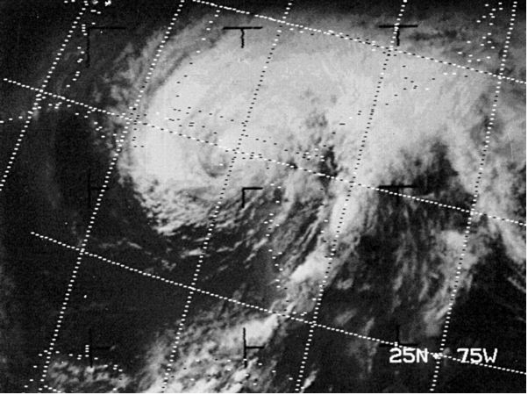
Agnes Landfall
TC Agnes made landfall on June 19, as a Cat 1 Hurricane, along the FL Panhandle
Notes:
Satellite image of Agnes making landfall along the FL coast.

Slide 7
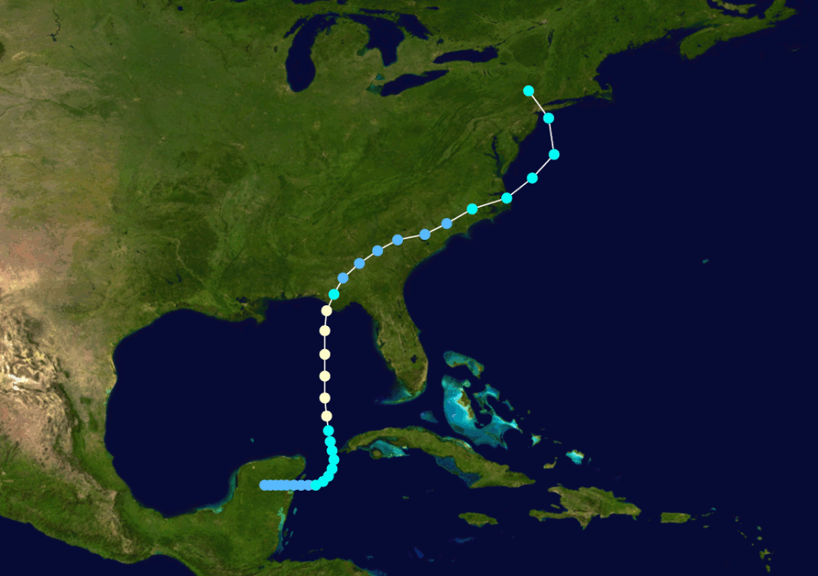
Inland Path of Agnes
Agnes then weakened to a TD, while making slow progress through GA and the Carolinas, 20-21 June
Notes:
The portion of Agnes’ track, when its PRE impacted NY/PA, is outlined by the orange ellipse.

Slide 8
00 UTC, 21 June, 1972
200 Heights/Winds
700 Heights/Winds
Denotes PRE location
Notes:
On the left, are analyzed 200 mb heights (white) and winds (color filled). On the right, are analyzed 700 mb heights (black) and wind barbs (red). Note the developing upper-level jet streak, well north of Agnes, over southern Ontario. At mid-levels, wind trajectories are transporting moisture from the vicinity of Agnes across the southeastern states, well northward into NY/PA. In both images, the orange ellipse outlines the location of the heaviest rainfall, associated with the PRE.

Slide 9
00 UTC, 21 June, 1972
850 Heights/PWAT
925 Heights/Theta-E
Theta-e ridge axis
Denotes PRE location
Notes:
On the left, are analyzed 850 mb heights (black) and precipitable water (color filled). On the right, are analyzed 925 mb heights (black) and theta-e values (color filled). Note the meridional transport of tropical moisture northward into the Ohio Valley and the Northeast. In both images, the orange ellipse outlines the location of the heaviest rainfall, associated with the PRE

Slide 10
PMSL, RH, and LI’s from 12z, 20 June to 00z, 21 June, 1972
L
L
“L” denotes center of Agnes circulation
Notes:
In the upper left, are mean sea-level pressure isobars, and analyses of pressure centers and frontal boundaries, valid at 12z, 20 June. The same data is displayed in the upper right, except valid 12 hours later, at 00z, 21 June. In the lower left, lifted indices are analyzed, for 00z, 21 June. In the lower right, relative humidity contours are analyzed, for 00z, 21 June. The PRE environment (over NY and PA) during this period, is characterized by a deep moist southerly flow, with only weak convective instability.

Slide 11
Buffalo, NY Sounding, 00 UTC, 21 June, 1972
WCD of around 3.5 km
Notes:
On this sounding profile, the warm cloud depth layer is shown between the two orange horizontal lines.

Slide 12
PRE Genesis and Evolution
Developing PRE rainfall; 18z, 20 June in OH/WV/KY
PRE rainfall near peak intensity across NY/PA; 06z, 21 June
Notes:
3-6 hour rainfall analyses are shown across the Mid-Atlantic/Northeastern states. In the upper left, the time frame is between 12z and 18z, 20 June. In the upper right, it’s between 18z, 20 June, and 00z, 21 June. In the lower left, it’s between 00z and 03z, 21 June. Finally, in the lower right, it’s between 03z and 06z, 21 June. The Agnes PRE first formed over WV and southeastern OH around 18z, 20 June. It eventually intensified and moved northeast, settling over PA/NY by 06z, 21 June.

Slide 13
12 UTC, 21 June, 1972
200 Heights/Winds
700 Heights/Winds
Denotes PRE location
Notes:
On the left, are analyzed 200 mb heights (white) and winds (color filled). On the right, are analyzed 700 mb heights (black) and wind barbs (red). Note that a strong upper-level jet streak is now in place over Ontario and Quebec. The PRE occurred squarely within the right entrance region of this upper-level jet. At mid-levels, wind trajectories continue to transport moisture from the vicinity of Agnes, well northward into NY/PA. In both images, the orange ellipse outlines the location of the heaviest rainfall, associated with the PRE.

Slide 14
12 UTC, 21 June, 1972
850 Heights/PWAT
925 Heights/Theta-E
Theta-e ridge axis
Denotes PRE location
Notes:
On the left, are analyzed 850 mb heights (black) and precipitable water (color filled). On the right, are analyzed 925 mb heights (black) and theta-e values (color filled). Note that the tropical moisture connection has become well established, feeding the PRE over NY and PA.

Slide 15
Latter Stages of the PRE
Rainfall still quite heavy from 09-12z, 21 June
By 18z, 21 June, intensity/organization had diminished
Notes:
3-6 hour rainfall analyses are shown across the Mid-Atlantic/Northeastern states. In the upper left, the time frame is between 06z and 09z, 21 June. In the upper right, it’s between 09z and 12z, 21 June. In the lower panel, it’s between 12z and 18z, 21 June. The Agnes PRE remained intense over NY and PA through about 12z, 21 June, before weakening by 18z.

Slide 16
Trajectory Analyses
Red – 850 mb (1.5 km AGL)
Blue – 700 mb (3 km AGL)
Green – 500 mb (6 km AGL)
L
L
Agnes track from 20-21 June
Notes:
Backward, multi-layered trajectories, with output from the NOAA Hysplit model, and ending at 12z, 21 June, are displayed. These results show a clear moisture connection in the lowest 6 km, between the PRE, and the main circulation of Agnes.

Slide 17
The Role of a Predecessor Rainfall Event (PRE) in the Devastating Floods Associated with Tropical Cyclone Agnes
PRE Comparisons
Notes:
This signals the beginning of slides in the “PRE Comparisons” section.

Slide 18
Agnes PRE Classification
Agnes PRE nicely falls into the “Southwesterly Jet” category
Strengthening jet streak to the north
Encouraged robust meridional transport of moisture from the TC towards the Mid-Atlantic/Northeastern states
Notes:
The latest CSTAR research on PRE (Moore, 2010) stratifies them into four separate categories. The PRE associated with Agnes matches the “Southwesterly Jet” category well. In this category, PRE typically form within the entrance region of a strong southwest to northeast oriented, cyclonically curved, upper-level jet maximum.

Slide 19
Upper-Level Flow / TC Position Comparison
SW Jet PRE Composite
200 mb - Agnes
L
L
Notes:
On the left is a composite of the 200 mb flow, for PRE within the “Southwesterly Jet” category, roughly 24 hours after PRE genesis. Note how closely the large-scale flow with the Agnes PRE (on the right) matches the composite.

Slide 20
Mid-Level Flow Comparison
SW Jet PRE Composite
700 mb - Agnes
Notes:
On the left is a composite of the 700 mb flow, with PWAT values color filled, for PRE within the “Southwesterly Jet” category, roughly 24 hours after PRE genesis. Note that, if anything, the large-scale flow with the Agnes PRE (on the right) is more amplified than the composite.

Slide 21
Low-Level Flow Comparison
SW Jet PRE Composite
925 mb - Agnes
Notes:
On the left is a composite of the 925 mb flow, with theta-e contours (red), and streamlines (blue), for PRE within the “Southwesterly Jet” category, roughly 24 hours after PRE genesis. Note that, once again, if anything, the large-scale flow with the Agnes PRE (on the right) is more amplified than the composite.

Slide 22
The Role of a Predecessor Rainfall Event (PRE) in the Devastating Floods Associated with Tropical Cyclone Agnes
Public Impact
Notes:
This signals the beginning of slides in the “Public Impact” section.

Slide 23
Basin Runoff Characteristics
Chemung Basin contribution
North Branch Susquehanna contribution
The majority of Chemung Basin runoff resulted from the PRE on 20-21 June (about 70% of event total rainfall)
In the headwaters of the Susquehanna, most of the rain fell from 22-23 June, when the main remnants of Agnes arrived
“Double- whammy” for Wilkes-Barre, PA
Notes:
A color coded chart of water routing within the Susquehanna River drainage basin. The black arrows illustrate the runoff contributions from both the Chemung River basin and the headwaters of the Susquehanna basin for Wilkes-Barre, PA. Heavy rainfall from the PRE was instrumental in producing record flooding at Wilkes-Barre (crest of nearly 41 feet).

Slide 24
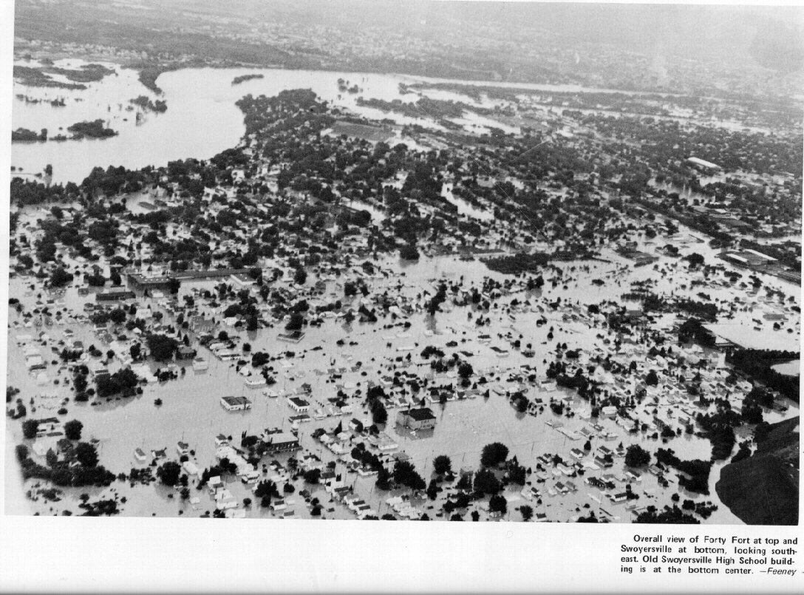
Catastrophic Flooding
Notes:
Flooding pictures from Corning, NY, along the Chemung River (upper left). Also from Wilkes-Barre, PA and surrounding areas in the Wyoming Valley, along the Susquehanna River (other three images).

Slide 25
Devastating Results
48 fatalities in PA, 33 in NY
122 total from Agnes
7.3 B in damages for PA, 2.4 B in NY
10.7 B total from Agnes
Widely recognized as the worst natural disaster in PA history
The PRE played an integral part
Was likely the main difference-maker that turned this into a historic/cataclysmic event
Notes:
Total costs of Agnes for NY and PA.

Slide 26
References
Bosart, L. and Carr, F., 1977. A Case Study of Excessive Rainfall Centered Around Wellsville, New York, 20-21 June, 1972. Mon. Wea. Rev. Vol. 106, 348-362.
Moore, B. J., 2010: Predecessor Rain Events. <www.atmos.albany.edu/student/bmoore/research/.../PRE_COMP.html>.
Galarneau, T. J., Jr., L. F. Bosart, and R. S. Schumacher, 2009: Predecessor rain events ahead of tropical cyclones. Mon. Wea. Rev., conditionally accepted.
Notes:
References cited for this presentation.

Slide 27
The End !!
Questions ??
Notes:
Final slide.

